Slide 1
ModSim Final
Effect of Blade Length on Maximum Extractable Wind Power and Efficiency
Eric Carson

Slide 2
TABLE OF CONTENTS
01
02
03
04
MODEL & SWEEP DESIGN
CR-HAWT
BACKGROUND
Introduce and define terms
Discuss design process and methodology
DISCUSSION OF RESULTS
CONCLUSION
Summarize findings and discuss future improvements to model
Display results and analysis of simulation

Slide 3
01
CR-HAWT BACKGROUND

Slide 4
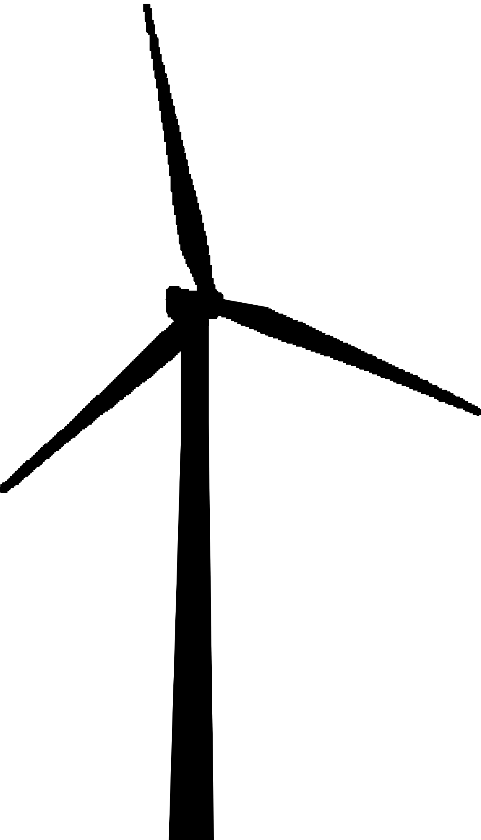
BACKGROUND
Wind electricity generation experienced significant growth in past 30 years
One of the fastest growing sources of electricity worldwide
Responsible for the generation of 434.81 billion kilowatt hours of energy in the US
Approximately 10.25% of the total US power consumption in 2022

Slide 5
BACKGROUND
Horizontal axis wind turbines (HAWTs)
Design improvements better efficiency, reliability, and cost-effectiveness
Design variation: Contra-rotating HAWT (CR-HAWT)
Two rotors mounted on the same axis, rotating in opposite directions
Result: reduced turbulence, increased wind flow
Notes:
The rear rotor operates in the wake of the front rotor, resulting in reduced turbulence and increased wind flow, which can generate more electricity with greater efficiency from the available wind sources.

Slide 6
Key Terms and Abbreviations
Contra-Rotating Horizontal Axis Wind Turbine
CR-HAWT
Single-Rotor Horizontal Axis Wind Turbine
SR-HAWT
Permanent Magnet Stator Motor
PMSM (shortened further to PSM in model)

Slide 7
02
MODEL & SWEEP DESIGN

Slide 8
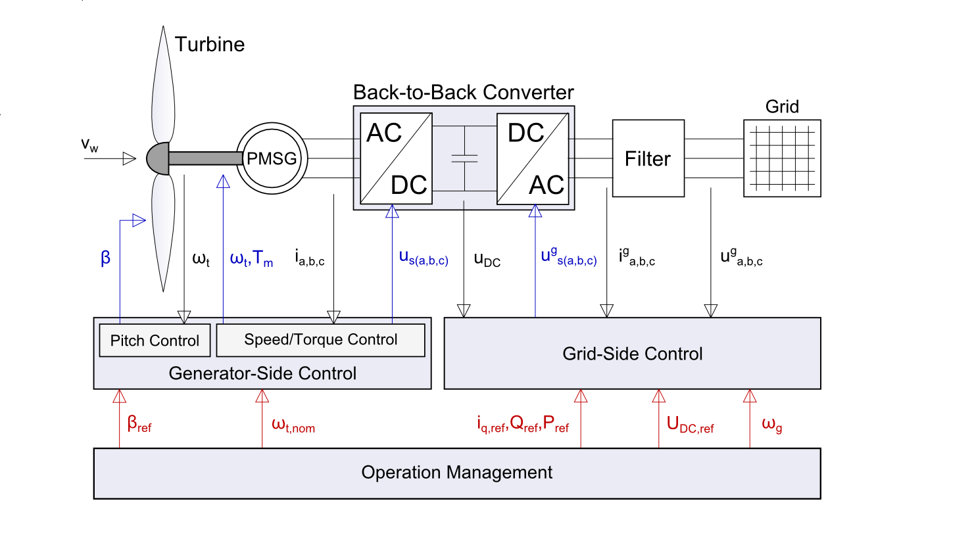
Wind Power Library
Wind Power library by Dassault Systèmes
Includes standard SR-HAWT model
Rated for 2 MWH
PMSM motor with fixed stator
Data specifying constants for standard model
Notes:
The library includes a standard wind turbine model, a single rotor HAWT (SR-HAWT) rated for 2 MWH, which is modeled as a permanent magnet synchronous motor (PMSM) with a fixed stator. The library also includes data specifying constants and equations relevant to this type of wind turbine

Slide 9
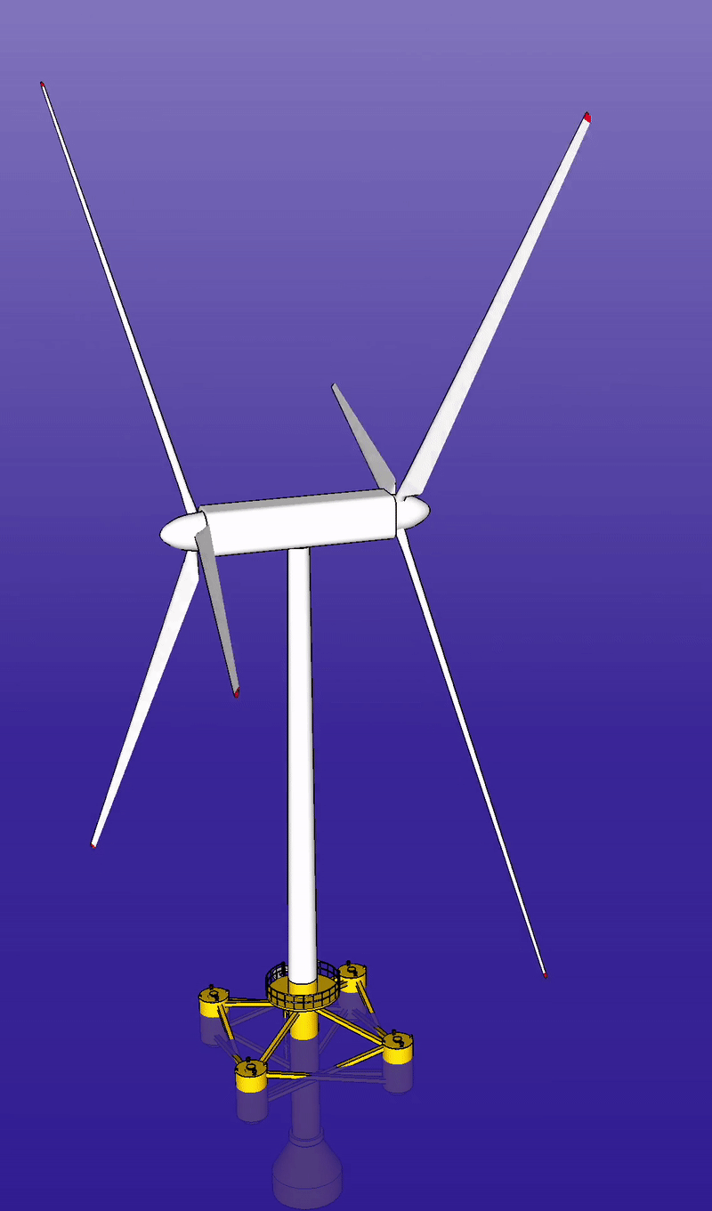
Modifications to Model
Second (rear) rotor added to stator
Stator unfixed which enabled a second port to connect second turbine to
Front turbine model duplicated for rear rotor and changed to rotate in the opposite direction
Removed random noise from wind source component to make results replicable
Both front and rear connected to wind source component
Propagated P_w and P_t upwards to top layer of model

Slide 10
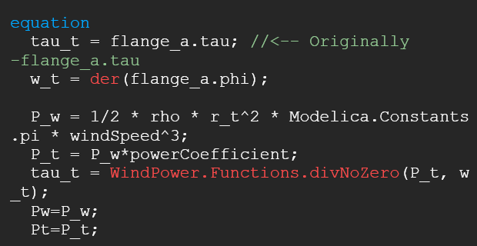
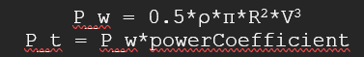
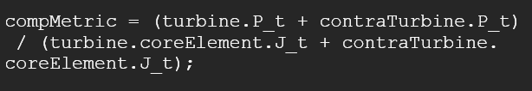
Notes:
P_w and P_t propagated upwards to make variable values more accessible.
A comparison metric was made to weigh the maximum extractable power (P_t) with the inertia of the rotating blades

Slide 11
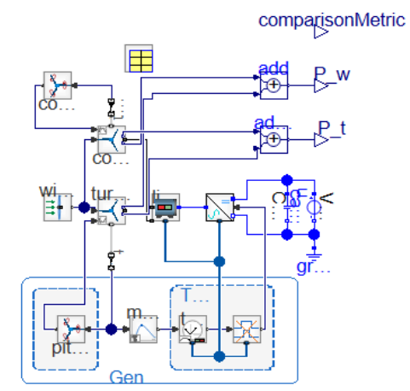

Slide 12
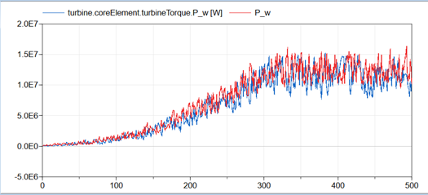
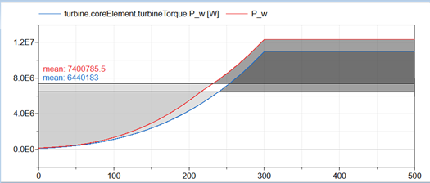
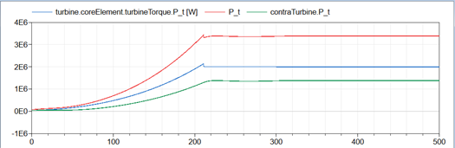
Notes:
Randomness in the wind source produces very large fluctuations in power output, reducing the reliability of simulation results.
Eliminating the randomness in the wind source produced more replicable results.
Plotting the overall P_t against the maximum extractable wind power from each wind turbine (bottom) confirmed the CR-HAWT model successfully combines the power output of the two wind turbines to produce a greater maximum extractable wind power than the SR-HAWT

Slide 13
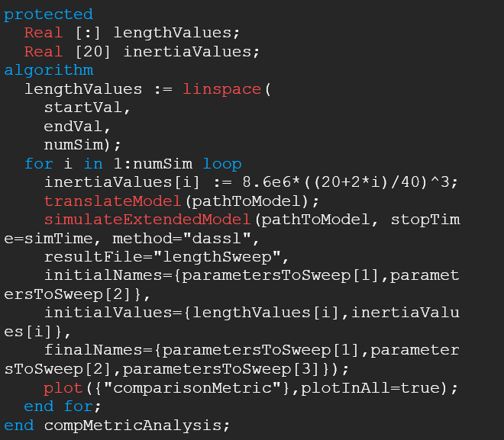
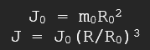
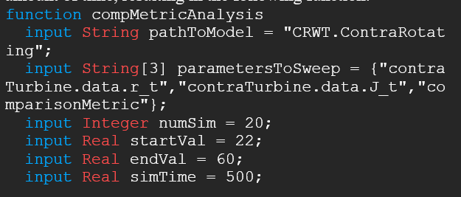
Sweep Design
Notes:
3 sweeps: comparison metric, power coefficient of contra turbine, and maximum extractable power
Radius and inertia modified in each iteration of sweep
Radius increases linearly from 22 to 60 meters and inertia increases cubically using the assumption that the mass the turbine increases proportionally with the length

Slide 14
03
RESULTS & DISCUSSION

Slide 15
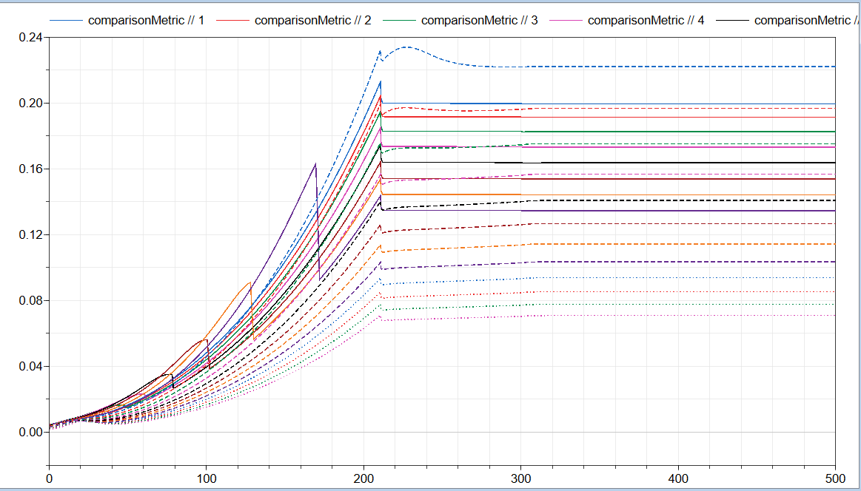
COMP-METRIC ANALYSIS
Notes:
The plot shows the sweep results.
The ninth iteration (blue dashed) is the optimal rear rotor length of the wind turbine rated for 2 MWH is 38 meters, 2 meters less than the front rotor length.
Results of the comparison metric sweep suggest that for wind speeds between 11-15 m/s, this 9th iteration is optimal

Slide 16
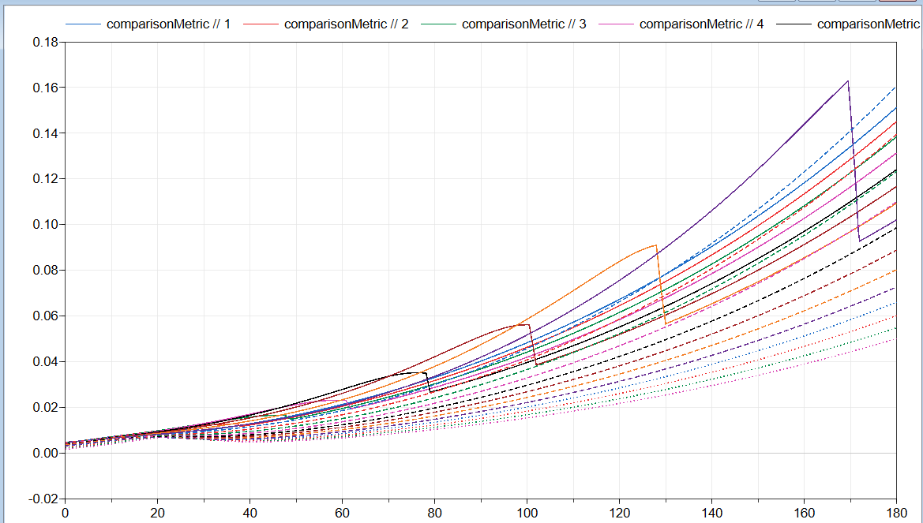
COMP-METRIC ANALYSIS
Notes:
For wind speeds lower than 11 m/s smaller rear rotors appear to make the turbine more efficient. Simulations with a rear wind turbine smaller than the front rotor are shown as solid lines

Slide 17
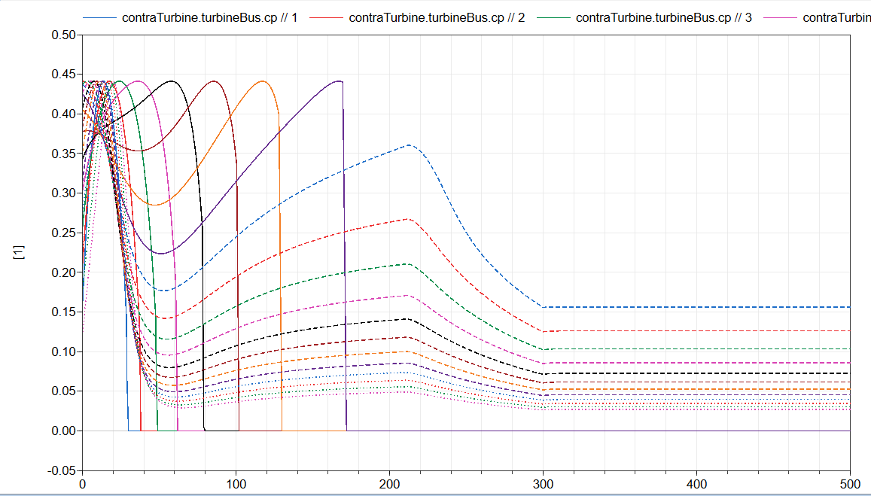
REAR ROTOR CP ANALYSIS
Notes:
The rear rotor power coefficient analysis matched the results of the comparison metric fairly well. The same trend was observed where the smaller rear rotors performed better at lower wind speeds. In interesting thing to note is for rear rotors with lengths less than 38 meters (solid lines), the efficiency of the rotors approaches zero, suggesting a very low power output.

Slide 18
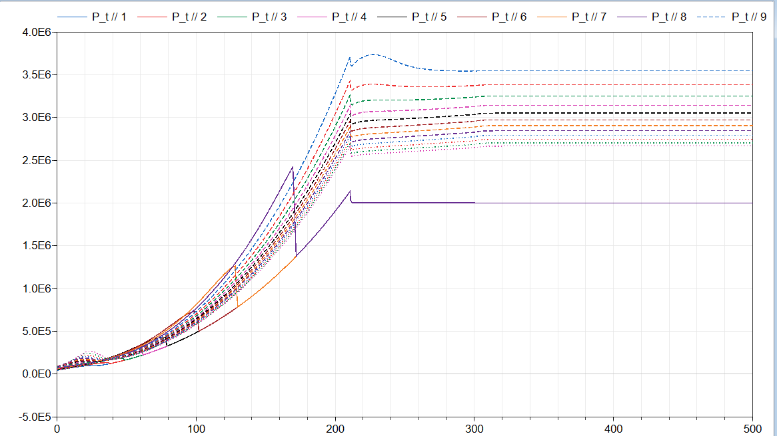
P_T ANALYSIS
Notes:
Running the P_t analysis confirms this is the case. The SR-HAWT example model reaches a final output of 2 megawatts, the same as the final output of the CR-HAWT models when the rear rotor is less than 38 meters. This sweep shows that despite the higher inertial values, having a rear rotor greater than or equal to the front rotor length can increase the power rating of the turbine.

Slide 19
04
PLANS FOR THE FUTURE

Slide 20
CONCLUDING REMARKS
Results from the sweeps indicate that a wind turbine would perform best with a rear rotor length of 38 meters
Small rear blade lengths are more efficient, but do not produce significantly more power than a SR-HAWT
Future model iterations can account for the wake of the front turbine and its effect on the rear rotor
Adjustment of maximum angular velocity
Notes:
The results from the sweeps clearly indicate that a wind turbine rated for 2 MWH with a front rotor length of 40 meters would perform best with a rear rotor length of 38 meters. Wind speeds between 11-15 m/s were found to work best for this blade length.
As blades change in size, the maximum angular velocity for the turbines changes inversely. Smaller blades can rotate faster, meaning if they were allowed to rotate faster in the model, then their power might not have dropped off halfway through the simulation

Slide 21
THANK YOU!
Please keep this slide for attribution

